Slide 1
Thomson Reuter Performance Classes
Class 1: July 1
Happy System Performance
Class 2: July 8
Advanced Performance Troubleshooting
Class 3: July 14
Advanced Performance “Lab”
Class 4: July 15
System Sizing Presentation
Class 5:July 22
OCPM “Lab”
Class 6: July 29
Open Question and Answer

Slide 2
Advanced Performance Troubleshooting
Tony Gaddis, Principal Performance Architect
(From Christopher Madden Presentation at Insight 2015)

Slide 3
Agenda
Setting the Stage
NetApp Clustered Data ONTAP® (cDOT) QoS Counters
WAFL® (Write Anywhere File Layout) Processing Fundamentals
WAFL Parallelization With Waffinity
Analyzing for a Performance Bottleneck
Key Takeaways

Slide 4
Setting the Stage
Raise your hand if:
You have seen a system with high CPU or busy disks and couldn’t explain why
Have heard you need multiple volumes to get maximum performance
Wanted to understand how much extra latency there was with indirect traffic

Slide 5
Setting the Stage
Today we will…
learn how QoS counters can show the latency breakdown within the cluster
look under the covers at how WAFL processes work
interpret perfstat section outputs to analyze for a WAFL related bottleneck
not leave with all the answers. Instead know where to probe further, either in your own troubleshooting or to suggest to technical support teams
To get value from this session you…
should have performance knowledge; sysstat, statit, and other commands are familiar to you
Notes:
This presentation assumes a existing NetApp performance analysis knowledge. If that knowledge is missing, this presentation may be difficult to understand or easy to misinterpret.

Slide 6
cDOT QoS Counters
How Can I Track Work Inside the Cluster?

Slide 7
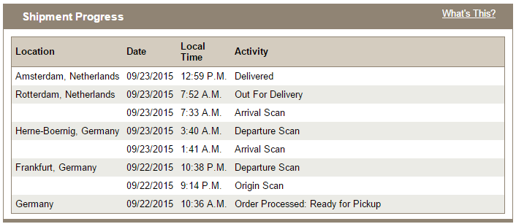
Track My Package
~5 hrs to my house
~20 min waiting
~4 hrs in route to Rotterdam
~2 hrs waiting
~3 hrs in route within Germany
~1 hr waiting
~11 hrs waiting
~26 hrs total time
~14 hrs wait time
~12 hrs service time
Notes:
An example of tracking a piece of work in a system with both wait time and service time components

Slide 8
Track My IO
Wouldn’t it be nice to track the IOs in my storage system just like I do a package?

Slide 9
Track my IO
Frontend (N-Blade)
Backend (D-Blade)
QoS Limit
NVLOG
CPU Exempt
CPU WAFL
CPU Exempt
RAM
CPU Network
CPU Protocol
CPU
CPU
FlashCache™ FlashPool™
D
CPU Network
Network
Interconnect
Suspend
Disk
Host
Per node
Service Center Wait Time Service Time Residence Time
D
Delay Center
Yes
Total latency
from service center
Queueing Center
Yes Yes
Notes:
Each IOP is tracked while it is in the cluster. Every microsecond is allocated to a service center where it is either waiting or processing. We can calculate the latency breakdown and know which service center is responsible for the most latency and thus we want to focus on if an improvement is desired. IOPs are tracked per workload. A workload is an entity that has been added to a QoS policy group, so this can be a file, lun, volume, or svm. Beginning in cDOT 8.3 we also always have volume level workloads defined regardless if policy groups are in use.
Not discussed here, but we can also flip workloads on their head and focus on the service center, aka ‘resource’ in the counter manager system. By looking from a resource perspective we can see the largest workload consumers of the resource which can be useful in bully/victim analysis.

Slide 10
Why Is This Important?
QoS counters
Use latency breakdown (aka ‘residence time’) to:
Identify the service center responsibility for the majority of latency
Give focus to further investigation or remediation steps to reduce that latency
Investigate into
Wait time: Is there excessive queueing?
Service time: Is too much CPU time spend servicing the request?
Visit count: Are there too many visits for a given service center?
Compare poor performing workloads to well performing ones and look for deviations

Slide 11
WAFL Processing Fundamentals
How Does WAFL Process Work?

Slide 12
WAFL Processing Architecture
WAFL is a message passing system
Exchanges information among workers without using shared memory
WAFL message is created by the frontend protocol layer (n-blade, scsi-blade)
NFS read == iSCSI read == SMB read == FCP read
WAFL processes messages (and nothing else!)
Example message types: WAFL_SPINNP_READ, WAFL_SPINNP_WRITE, WAFL_SETATTR, WAFL_SMB_OPEN, WAFL_DECOMPRESS, etc
Uses a Suspend / Restart model
Notes:
WAFL processes messages. These messages are created by itself or others. WAFL has no awareness of protocols.

Slide 13
Suspend / Restart Model
A message is added to a queue, and when at the front it is put on CPU
If the message can complete it will. If not, it will suspend due to:
Required data is not in cache (RAM)
Required data is locked
Needs to run on a different affinity, potentially because more exclusive access to data structures is required
Preempt itself because it was running too long and doesn’t want to starve other messages
The message will restart returning to step 1. when
The missing data has been loaded in cache
The lock has been free’d
Immediately re-queued
Notes:
It would be nice if a message would never suspend because that offers the lowest latency and least work for WAFL. But, for almost all workloads suspends are inevitable and expected because it’s simply not possible for data to be in cache all the time. Understanding the suspend/restart mechanism is useful to diagnosing latency at the WAFL layer.

Slide 14
WAFL Processing Architecture
Example read from cache
Frontend (N-Blade)
Backend (D-Blade)
Suspend
NVLOG
WAFL_SPINNP_READ
RAM
D
Read
FlashCache FlashPool
WAFL
Disk
Yes!
Is data in cache (RAM)?

Slide 15
WAFL Processing Architecture
Example read from flash
Frontend (N-Blade)
Backend (D-Blade)
Suspend
NVLOG
WAFL_SPINNP_READ
RAM
WAFL_SPINNP_READ
D
Read
FlashCache FlashPool
WAFL
D
Disk
Is data in cache?
No. Message suspends on reason like BUF_EC_READ or LOAD_BUF_SSD_DISK_LOCK_CHILD. Data is requested.
Data is copied to cache
and message is restarted.
Is data in cache?
Yes!

Slide 16
WAFL Processing Architecture
Example write NVLOG available space
Frontend (N-Blade)
Backend (D-Blade)
NVLOG
Suspend
D
RAM
WAFL_SPINNP_WRITE
D
Write
FlashCache FlashPool
WAFL
Disk
Yes!
Can commit to NVLOG?

Slide 17
WAFL Processing Architecture
Example write NVLOG full (back-to-back CP due to log full)
Frontend (N-Blade)
Backend (D-Blade)
NVLOG
D
Suspend
FULL
WAFL_SPINNP_WRITE
RAM
WAFL_SPINNP_WRITE
D
Write
FlashCache FlashPool
WAFL
Disk
Can commit to NVLOG?
No. Message suspends on reason like ‘PRE_NVLOG_FULL’. Wait until space is available in log.
NVLOG is emptied
and message is restarted.
Can commit to NVLOG?
Yes!

Slide 18
WAFL Processing Architecture
Example directory listing
Frontend (N-Blade)
Backend (D-Blade)
Suspend
NVLOG
WAFL_SPINNP_READDIR
WAFL_SPINNP_READDIR
RAM
D
WAFL_SPINNP_READDIR
WAFL_SPINNP_READDIR
D
SMB File Find
FlashCache FlashPool
WAFL
D
Disk
D
Is directory data in cache?
No. Message suspends on reason like ‘LOAD_BUF_DISK_LOCK_CHILD’. Data is requested.
Directory data is copied to cache
and message is restarted.
No. Message suspends on reason like “READ_BUF_IO_WAIT_INOFILE’. Data is requested.
Is directory data in cache?
Yes, filename found. Is last modified date in cache?
Inode data is copied to cache
and message is restarted.
Is last modify date in cache?
Yes!

Slide 19
Why Is This Important?
WAFL processing
Messages that don’t restart have low latency from the WAFL layer comprised of:
Queue time for WAFL (0us-300us*)
Service time in WAFL (1us-150us*)
Messages that need to restart have higher latency because
they have to wait until their need is satisfied; could be 5ms+* if coming from disk
they have to pass through WAFL again; if WAFL is busy can be non-trivial and we make WAFL even busier
multiple restarts can lead to much higher latency for the message
Note: Some messages are ‘large’ by design and will restart many times before completion
Typically messages generated by background scanners such as dedupe or truncating deleted blocks where user latency is not directly impacted
* Typical range on a healthy system for scale purposes

Slide 20

Read Fast Path to Storage Optimizations–8.3 and 8.3.1
Data ONTAP® 8.2.x vs 8.3 vs 8.3.1
8.2.x
8.3
8.3.1
request
response
Network
Network
Network
WAFL
WAFL
WAFL
RAID
RAID
RAID
Storage
Storage
Storage
Notes:
8.2.x
Every read request that requires accessing blocks from drives (HDDs or SSDs) is passed to each layer of the software from Networking to WAFL to RAID and finally to Storage. The same path in reverse order happens as blocks are passed up to system memory buffers before being sent to the requesting host or client.
8.3
Read responses from SSDs are passed directly from RAID to Networking – bypassing WAFL. When RAID has to correct an error, it responds to WAFL instead of Networking.
8.3.1
Read requests are passed directly from WAFL to Storage, bypassing RAID. RAID code provides little value-add on read requests.
Read responses are passed directly from Storage to Networking, bypassing both RAID and WAFL. When a checksum error is detected, Storage responds to WAFL.

Slide 21
WAFL Parallelization With Waffinity
How Does WAFL Use Many Cores?

Slide 22
Data ONTAP and Multiple Cores
Take a step back for context…
Data ONTAP schedules threads to run on cores
Optimized by the kernel scheduler and varies per release and hardware model
Don’t look at per physical core utilization!
Any work done by Data ONTAP must be tagged to run in a specific domain
Example: RAID_Ex is RAID, Nwk_Exmpt is IP and NFS work, Kahuna is serial WAFL, WAFL_Ex is parallelized WAFL, etc
Each domain has rules about their level of concurrency (simultaneous active cores)
In the case of WAFL, only Kahuna or WAFL_Ex can be active simultaneously
For more details see KB3014084 “FAQ: CPU Utilization in Data ONTAP: Scheduling and Monitoring”
Now we will dive into WAFL parallelization

Slide 23
WAFL Parallelization With Affinities, aka Waffinity
An affinity is a WAFL work queue
Analogous to Data ONTAP’s CPU domains for total system work
Allows concurrent messages to be processed in a safe manner
Each message is set to run in an affinity
A given message type might run in different affinities depending on the data structures accessed
May change with new Data ONTAP releases
An affinity hierarchy defines the rules about which affinities can run concurrently
At any point in time many affinities are likely active on CPU

Slide 24

Waffinity hierarchy
AGGR_VBN_RANGE 0
AGGR_VBN_RANGE N
VOL_VBN_RANGE N
Structure includes Aggregate and Volumes
Different aggregates and volumes can process work concurrently
Allows various levels of exclusivity to data structures
Affinities can have
siblings such as STRIPE threads with each other
parents, such as VOL_LOG is parent to STRIPE
children, such as AGGR is a child of SERIAL
Concurrency rules
Siblings can run concurrently
children can not run if parent is running, applies recursively
VOL_VBN_RANGE 0
STRIPE 0
…
STRIPE N
…
…
VOL_VBN
xcleaner
High Low
Exclusivity of Access
AGGR_
VBN
VOL_LOG
VOL
AGGR
SERIAL

Slide 25
Waffinity hierarchy affinity details
STRIPE: Exclusive access to a block range, READ and WRITE often here, GETATTR
VOL_LOG: Volume logical actions like CREATE, SETATTR, LINK
VOL_VBN, VOL_VBN_RANGE: Block level access like SnapMirror, other WAFL metadata work
VOL: Access to any file in the volume and used for actions like REMOVE
AGGR_VBN, AGGR_VBN_RANGE: WAFL metadata and bitmap work
AGGR: Access to any file in the aggregate
SERIAL: Complete system wide serialized access
AGGR_VBN_RANGE 0
AGGR_VBN_RANGE N
VOL_VBN_RANGE 0
VOL_VBN_RANGE N
STRIPE 0
…
STRIPE N
…
…
VOL_VBN
xcleaner
High Low
Exclusivity of Access
AGGR_
VBN
VOL_LOG
VOL
AGGR
SERIAL
Notes:
CHANGED

Slide 26
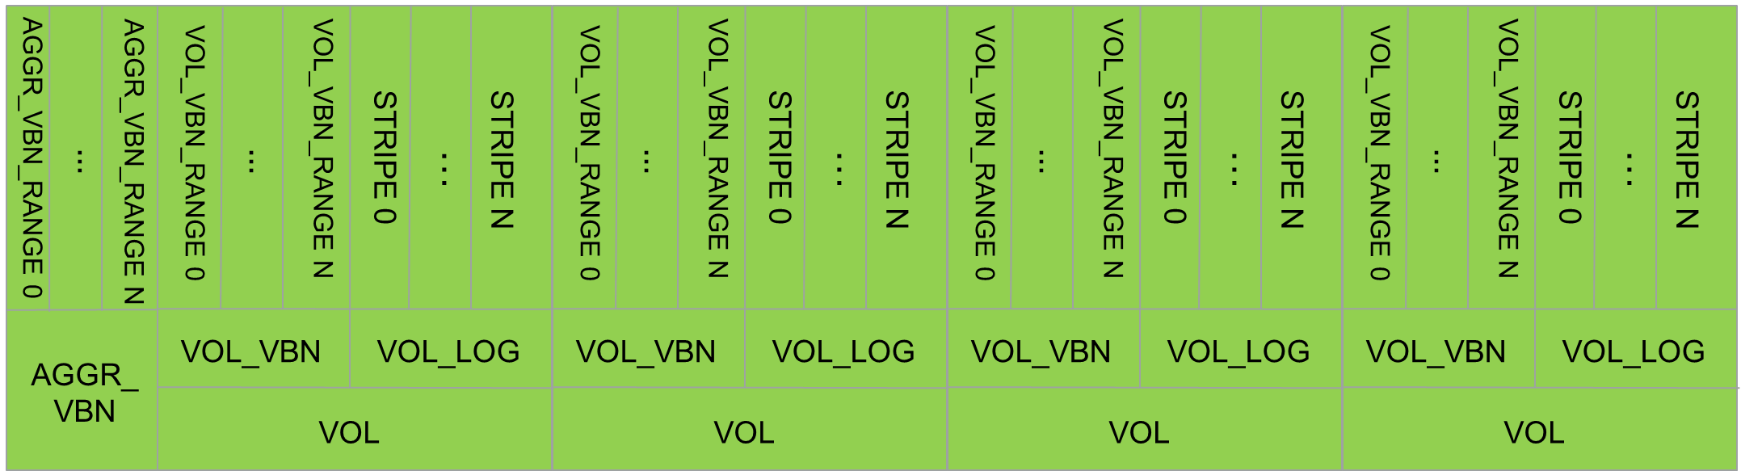

Waffinity hierarchy affinity details
xcleaner
High Low
Exclusivity of Access
AGGR
AGGR
SERIAL
* Affinity quantities vary by model and Data ONTAP release and are documented at the top of waffinity_stats output
Notes:
CHANGED

Slide 27
Why Is This Important?
Waffinity
If WAFL processing latency is high, be able to identify if the bottleneck is related to affinities
Data layout can cause an affinity bottleneck
On a node with many cores, one volume cannot saturate CPU resource
Some workloads can achieve less parallelization than others
More volumes are needed to have multiple affinity families active
Some message types still require more exclusive access
For some less common workloads, the use of more smaller nodes vs. fewer larger nodes, might be suggested

Slide 28
Analyzing for a Performance Bottleneck
Where Is the Bottleneck and What Causes It?

Slide 29
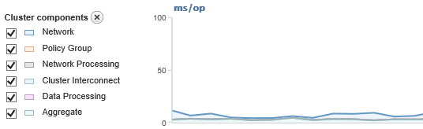
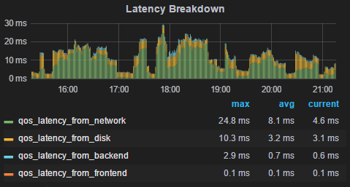
Using QoS Counters
Onsite viewers
OnCommand Performance Manager
NetApp Harvest with Grafana
cDOT Command Prompt
cdot1::> qos statistics workload latency show
Workload ID Latency Network Cluster Data Disk QoS NVRAM
--------------- ------ ---------- ---------- ---------- ---------- ---------- ---------- ----------
lun_1-wid13895 13895 6.14ms 2.04ms 0ms 432.00us 3.67ms 0ms 74.00us
lun_1-wid13895 13895 6.03ms 2.48ms 0ms 420.00us 3.12ms 0ms 66.00us
lun_1-wid13895 13895 4.99ms 2.19ms 0ms 444.00us 2.36ms 0ms 69.00us

Slide 30
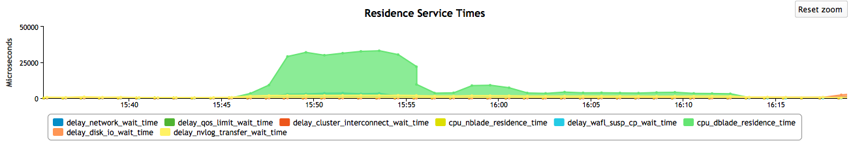
Using QoS Counters
Remote using PerfViewer Workload view
Trigger a performance archive for the historical timespan of concern (see KB 3014366)
Requires HTTP/HTTPS ASUP to NetApp and cDOT 8.3+
Use SmartSolve to open PerfViewer to view performance archive

Slide 31
Using QoS Counters
Remote using perfstat and Latx
Load perfstat into Latx
Choose Reports -> Report View -> Intelligent Views -> Workloads
View overall workload:
View per node QoS details:
Op/s | Weighted Avg Latency
2491 | 6840.37
Service Center | Visits | Wait Time | Service Time | Visit Ratio | Residence Time
CPU_wafl_exempt | 5573 | 372.2 | 46.25 | 2.23 | 936.18
CPU_protocol | 17691 | 40.69 | 5.05 | 7.10 | 324.84
DELAY_CENTER_WAFL_SUSP_OTHER | 352 | 2106.72 | 0 | 0.14 | 297.7
DELAY_CENTER_NETWORK | 2870 | 493.95 | 0 | 1.15 | 569.1
DELAY_CENTER_DISK_IO | 2803 | 4150.12 | 0 | 1.12 | 4669.93
DELAY_CENTER_NVLOG_TRANSFER | 5192 | 20.45 | 0 | 2.08 | 42.62

Slide 32
QoS Summary
Use QoS counters to determine largest latency contributor
If ‘explained‘
Move workload to a different node or aggregate, modify QoS throttle, recommend a hardware upgrade, etc
Stop; no deeper investigation needed!
If ‘unexplained’ and sourced at WAFL (aka d-blade)
Drive deeper into WAFL and Waffinity to see why

Slide 33
WAFL Troubleshooting
wafl_susp -w
Includes information like:
New count per message type
Restart count per message type
Suspend reasons and duration of suspends
waffinity_stats
Includes information like:
New count per message type per affinity
Affinity activity level, average time to process a message, average wait time
Shows WAFL activity and suspends
Shows affinity usage and queueing latency

Slide 34
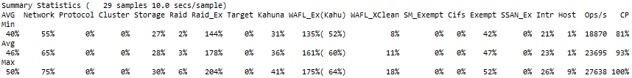
Customer Complains About Sluggish FAS6290 System
5-7ms for these very lightweight metadata ops; should be less than .5ms
nfsv3:nfs:nfsv3_op_latency.getattr:5392.47us
nfsv3:nfs:nfsv3_op_latency.setattr:8834.20us
nfsv3:nfs:nfsv3_op_latency.lookup:7485.74us
nfsv3:nfs:nfsv3_op_latency.access:5317.19us
nfsv3:nfs:nfsv3_op_latency.mkdir:10890.01us
nfsv3:nfs:nfsv3_op_latency.read:46567.95us
nfsv3:nfs:nfsv3_op_latency.write:6683.96us
nfsv3:nfs:nfsv3_op_latency.create:13840.79us
nfsv3:nfs:nfsv3_op_latency.remove:874317.98us
nfsv3:nfs:nfsv3_op_latency.rmdir:14674.17us
nfsv3:nfs:nfsv3_op_latency.rename:34019.60us
nfsv3:nfs:nfsv3_op_latency.link:10541.95us
nfsv3:nfs:nfsv3_op_latency.readdir:4692.38us
nfsv3:nfs:nfsv3_op_latency.readdirplus:19059.08us
nfsv3:nfs:nfsv3_op_latency.fsstat:3413.31us
46ms for reads (disks?) 6.7ms for writes (odd, writes are usually 1ms or less or much higher if system is overrun)
874ms for a remove, that is slow
sysstat –M shows
Notes:
This is a 7-mode example. cDOT WAFL layer is the same as 7-mode but 7-mode was shown because the data demonstrates WAFL suspends and a bottleneck in Waffinity.

Slide 35
Using wafl_susp -w
Excerpt of new message table
Find header
Look to new message count to understand workload profile (ignore _DONE messages)
Look to restarts to understand suspend frequency
message type new restarts
(cnt) (cnt)
SK_SIGNAL_MSG = 11756 0
WAFL_GETATTR = 3993915 50
WAFL_SETATTR = 807439 9663
WAFL_LOOKUP = 1937767 229034
WAFL_DOACCESS = 2751205 3
WAFL_READ = 1446816 3514268
WAFL_WRITE = 1766786 34957
WAFL_CREATE = 225630 22429
WAFL_MKDIR = 462 68
WAFL_REMOVE = 328149 436251
WAFL_RMDIR = 16 4
WAFL_RENAME = 432096 66076
WAFL_LINK = 141663 5036
WAFL_READDIR = 62827 39494
WAFL_STATFS = 5134 94
From this output:
NFS workload with a mix of metadata and r/w
Reads restart an avg of 2.4 times
Removes restart an avg of 1.3 times

Slide 36
Using wafl_susp -w
Excerpt of suspend reasons for WAFL_READ
Find header at top of output
Scan for message name and find suspend reason above it
See count, average and max suspend times (in ms)
Suspend Because: Count AvgSusp MaxSusp
LOAD_BUF_DISK_LOCK_CHILD
WAFL_READ 943069 11.46 315
READ_BUF_IO_WAIT_CONTAINER
WAFL_READ 13714 12.08 154
READ_BUF_IO_WAIT_HYA_CACHE
WAFL_READ 470662 7.11 115
READ_BUF_IO_WAIT_OTHER
WAFL_READ 1946797 9.21 295
READ_HYA_CACHE_WRX
WAFL_READ 119808 5.40 137
Observations:
Most reads are waiting on disk for 9ms to 12ms on avg
Even Hybrid Aggr SSD reads are waiting 5-7ms on avg
There are no other significant suspend reasons
Average suspend time per message is 9.4ms * 2.4 suspends = 23ms per message
Notes:
So we had NFS layer read latency of 46ms. We then learned that each message restarts an average of 2.4 times.
Avg time per suspend is 9.4ms (weighted average of all suspend reasons avgsusp time) * 2.4 times on avg = 23ms per message.
So we still need to account for another 46ms – 23ms = 23ms

Slide 37
Using wafl_susp -w
Excerpt of suspend reasons for WAFL_REMOVE
Observations:
Removes that suspend are mostly because of ZOMBIE_MSGS for an avg of 412ms, and at least one remove took 5.7s.
Some removes are also suspending on avg 72ms due to locking related to inode processing in a CP
Average suspend time per message is 331ms * 1.3 suspends = 431ms per message
Suspend Because: Count AvgSusp MaxSusp
LOAD_INODE_WIP_IN_CP
WAFL_REMOVE 103758 72.44 1111
ZOMBIE_MSGS
WAFL_REMOVE 331111 412.54 5705
Notes:
So we had NFS layer rm latency of 874ms. We then learned that each message restarts an average of 1.3 times.
Avg time per suspend is: (103758 * 72.44) + (331111 * 412.54) / (103758 + 331111) = 331.39ms per suspend/restart.
We restart 1.3 times avg * 331.39 avg per suspend = 430.8ms per message.
So we still need to account for another 874ms – 431ms = 443ms

Slide 38
Using waffinity_stats
Waffinity configuration shown at the top of the command output
2 Aggregate affinities
Waffinity configured with:
# AGGR affinities : 2
# VOL affinities / AGGR affinity : 4
# STRIPE affinities / VOL affinity : 5
# total VOL affinities : 8
# total STRIPE affinities : 40
# total affinities : 101
# threads : 11
4 Volume affinities per Aggregate
5 Stripe affinities per Volume
11 threads created for waffinity giving a max of 1100% CPU for WAFL_Ex; affinities will be run on those threads
Note: this output is taken from a 12 core FAS6290 running DOT 8.2
Notes:
This table is at the top of every waffinity stats and shows the affinities that are created for the platform on the active release. Generally speaking the more cores you have the more affinities and threads you have.

Slide 39
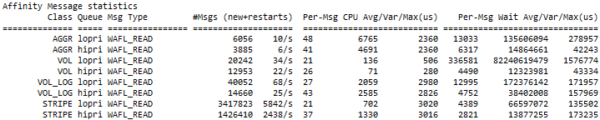
Using waffinity_stats
Waffinity processing of reads
Observations:
Most messages are processing in the STRIPE affinity (good, since this offers the most parallelization)
Once on CPU only 21-37us is needed
But, it takes 2.8ms – 4.3ms waiting to get on CPU!
WAFL queueing adds 13.4ms avg per message
Find the Affinity Message statistics section and the message of interest, in our case WAFL_READ
Check the affinity class with the highest message count
Check the avg CPU time
Check the avg wait time for CPU
Notes:
From earlier we had NFS layer read latency of 46ms. We then learned that each message restarts an average of 2.4 times.
We learned that we were suspended on disk (HDD or SSD) for avg 23ms per message. So that leaves 23ms unaccounted.
Here we see that on the first pass through (in hipri) we waited 2.8ms, then our 2.4 restarts waited 4.4ms each:
2.8 + (2.4 * 4.4) = 13.36ms
So we see that our 46ms protocol latency had a WAFL wait time component of 13.3ms, and disk wait time of 23ms = 36ms total from WAFL (technically you also have to add service time on CPU, but it’s so small I skip the effort here). The remaining wait time is somewhere outside of WAFL.

Slide 40

Using waffinity_stats
Waffinity processing of removes
Observations:
Messages are processing in the VOL affinity (because more exclusivity is needed)
Once on CPU only 27-51us is needed
But, it takes 4.4ms – 335ms waiting to get on CPU!
WAFL queueing adds 438ms avg per message
Notes:
From earlier we had NFS layer rm latency of 874ms. We then learned that we suspended avg 1.3 times with avg 430.8ms per message.
So we still need to account for another 874ms – 430ms = 444ms
Here we see that on the first pass through (in hipri) we waited 4.4ms, then our 1.3 restarts waited 335ms each:
2.8 + (1.3 * 335) = 438ms
So we see that our 874ms protocol latency had a WAFL wait time component of 438ms, and suspend wait time of 431ms = 869ms total from WAFL (technically you also have to add service time on CPU, but it’s so small I skip the effort here). This aligns very closely with protocol latency.

Slide 41
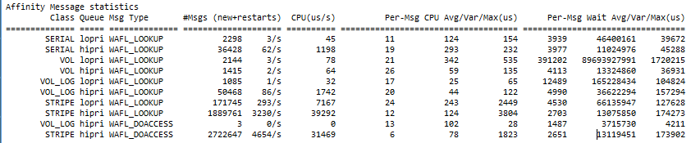
Using waffinity_stats
Waffinity processing of access and lookup and messages
Observations:
~8000/s access and lookup messages are processing in the STRIPE affinity
Once on CPU only 6-12us is needed
But, it waits for ~2.7ms to get on CPU!
Explains the high NFS access and lookup latency we saw earlier
Notes:
CHANGED

Slide 42
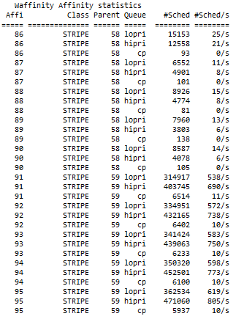
Using waffinity_stats
Check affinity families
Find the Waffinity Affinity statistics section
Each affinity has an id, a queue, and a parent that defines the hierarchy it belongs to
Check how busy each affinity is
Observations:
One set of STRIPEs with parent 59 is active
One set of STRIPEs with parent 58 is not active
No other STRIPEs exist (although this platform should have many more if there are more volumes)
Very unbalanced use of Waffinity
Notes:
We saw at the very beginning that avg CPU was 46%, so if there is queueing in waffinity it must be related to scheduling of individual affinities.

Slide 43
WAFL Analysis Summary
Further review showed only a single volume was configured on a FAS6290 and was receiving ~20-45k IOPs
Queueing in Waffinity caused excessive wait time for all requests (2-5ms was typical)
IOPs answered from memory would be impacted most (ex: .5ms -> 5ms; 10x increase)
Any operation that is suspended incurs the wait time on each restart
Resolution is to distribute the workload amongst volumes
Four or more per node would be recommended

Slide 44
Understand what a WAFL message is and the suspend / restart model
Be able to interpret wafl_susp -w and waffinity_stats
Optimize data layout and workload for improved performance

Slide 45
Related Sessions and Resources
Learn more about this topic
Attend sessions:
1687-3-TT - Identifying Storage System Bottlenecks with Perfstat
1688-4-TT - Advanced Storage Bottleneck Analysis with Perfstat
1780-2 - Monitoring Performance Using NetApp® OnCommand® Performance Manager and API extensions
2258-3-TT - Real-time Monitoring of Clustered Data ONTAP®

Slide 47






Stay Connected
Follow NetApp Insight on Facebook and Twitter
Christopher Madden
http://blog.pkiwi.com It all begins with data
https://twitter.com/dutchiechris
Insight US
Insight EMEA

